Slide 1


Walmart Superstore Sales Analysis Dashboard By Tulassidevi 07-05-2024

Slide 2
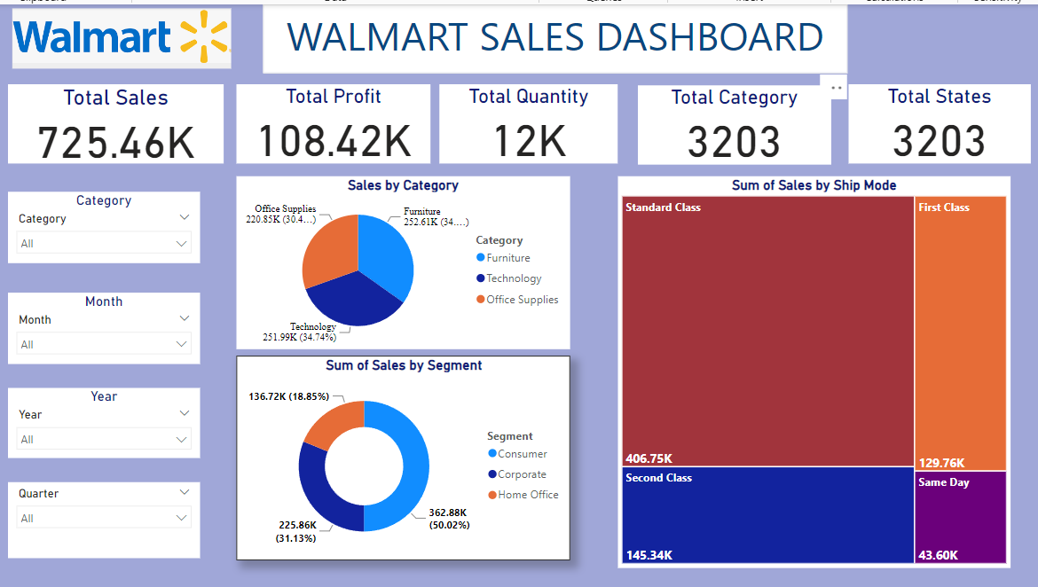
OVERVIEW WALMART SALES DASHBOARD
Total sales, profit, quantity, category, states.
Sales by category, segment, ship-mode.
Slicer is applied for category, month, year, quarter.

Slide 3
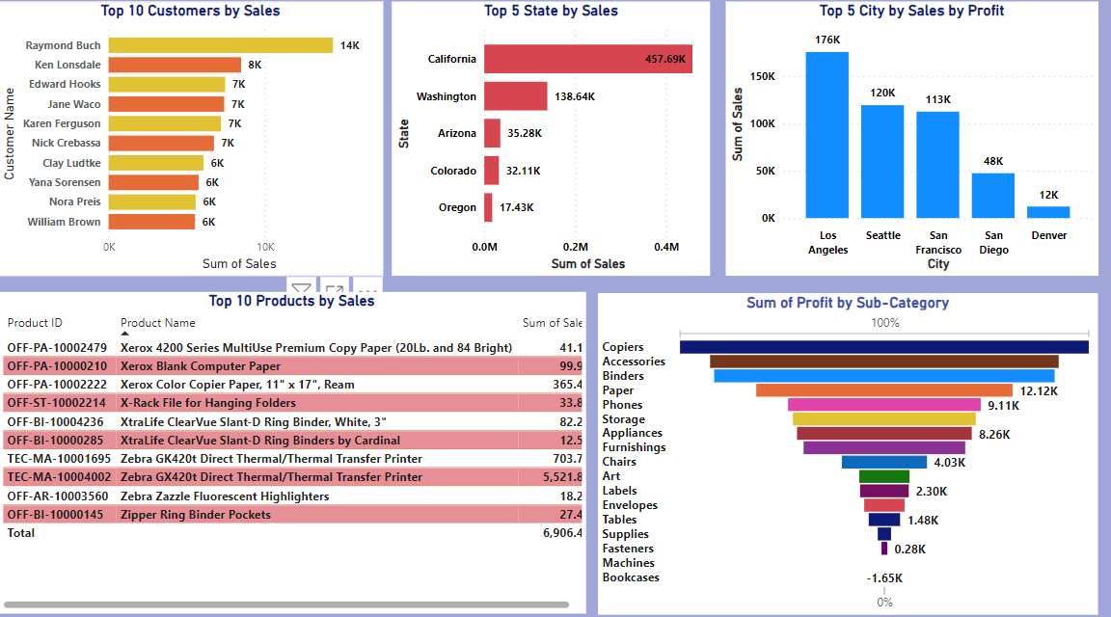
TOP CUSTOMERS,STATE,CITY,PRODUCTS
Top 10 customers by sales, products.
Top 5 state by sales.
Top 5 city by profit.
Sum of profit by subcategory.

Slide 4
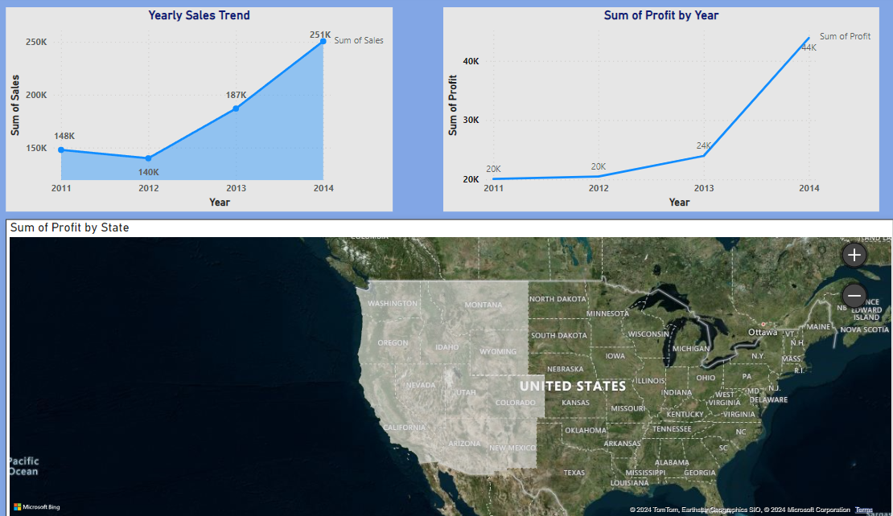
SALES TREND
Yearly sales trend
Profit by year
Geographical representation profit by state

Slide 5
THANKYOU

